Slide 1
Functions & Pointers

Slide 2
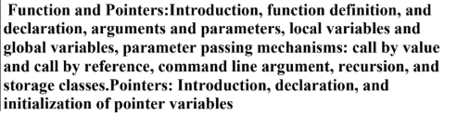
Syllabus

Slide 3
What is a Function?
A function is a block of code that performs a specific task and can be reused many times.

Slide 4
What is a Function?
A function is like a small ready‑made machine that does one specific job, and you can use it again and again whenever you need that job done.
Think of a function as a button on a machine:
You press the button (call the function),
The machine (function) does its job,
Then it may give you a result or just do something (like printing a message).

Slide 5
What is a function? : Real‑life example
Imagine you work in a coffee shop and your job is:
Every time a customer says “prepare coffee”, you:
Take a cup
Add coffee powder
Add hot water
Stir and serve

Slide 6
What is a function? : Real‑life example
void prepareCoffee() {
printf("Step 1: Take a cup\n");
printf("Step 2: Add coffee powder\n");
printf("Step 3: Add hot water\n");
printf("Step 4: Stir and serve\n");
}
You can think of this as a “prepareCoffee()” function in code:
Now, whenever a customer comes, you just call: prepareCoffee(); // press the "prepare coffee" button
You don’t rewrite all the steps every time; the function remembers them.

Slide 7
Point | Why functions are needed
Reusability | Same code can be used many times by just calling the function instead of writing it again and again.
Reduced repetition | If a task is repeated, you write it once in a function and call it whenever needed.
Organized code | Large programs are split into small functions, each doing one clear task, so code becomes clean and easy to read.
Easy debugging | If something is wrong, you can check and fix only that function without touching the whole program.
Easy testing | You can test one function separately to make sure it works correctly before using it in the full program.
Avoids errors | Changing logic in one function updates it everywhere it is used, reducing mistakes from repeated code.
Abstraction | You can use a function just by knowing what it does (interface), without worrying how it works inside.

Slide 8
Why use a function?
Avoid code repetition
Make code easy to understand
Divide big problems into small parts
Improve readability and maintenance

Slide 9
Example of a function?
#include <stdio.h>
void greet() {
printf("Hello!\n");
}
int main() {
greet(); // function call
return 0;
}

Slide 10
What is a function? Definition?
It is the actual body of the function where the work is done.
Syntax
return_type function_name(parameters) {
// body
}

Slide 11
What is a function declaration?
It tells the compiler:
Function name
Return type
Parameters
It is written before main()
Syntax
return_type function_name(parameters);

Slide 12
Arguments and Parameters
Parameter
Variables in function definition
Receive values
Argument
Actual values passed during function call

Slide 13
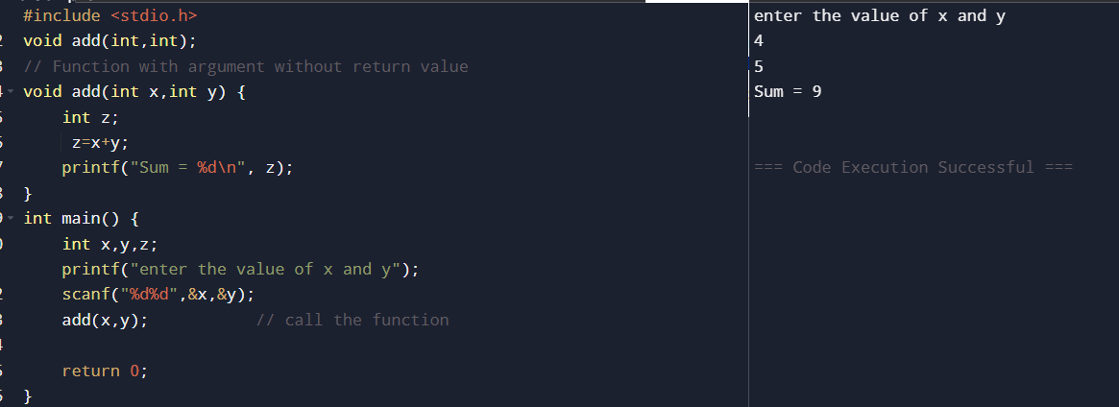
A Function with argument without return value

Slide 14
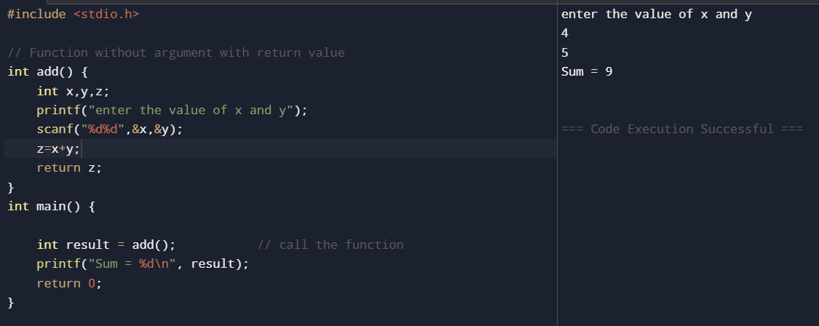
A function without argument with return value

Slide 15
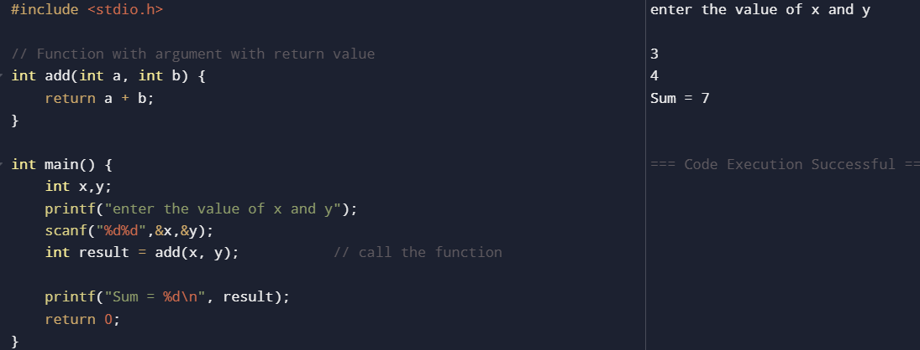
A function with argument with return value

Slide 16
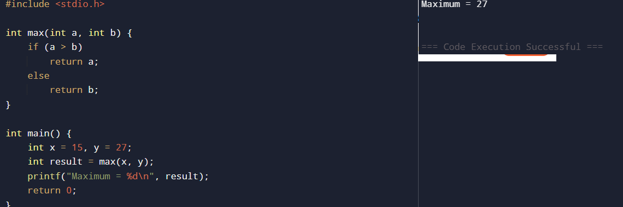
Find maximum of two numbers

Slide 17
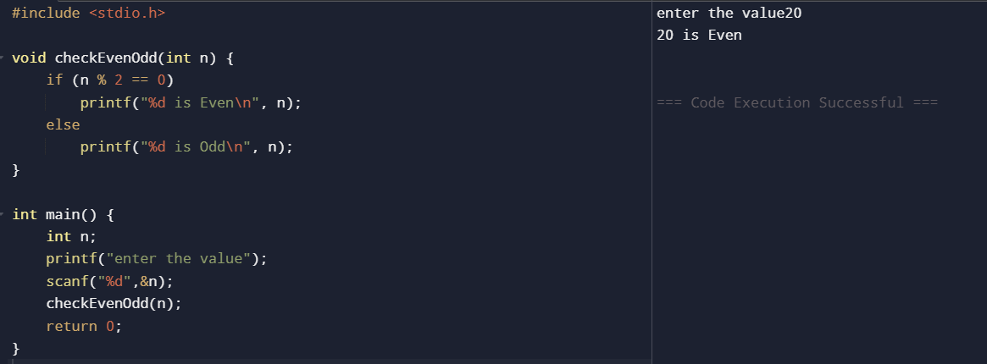
Check even or odd

Slide 18
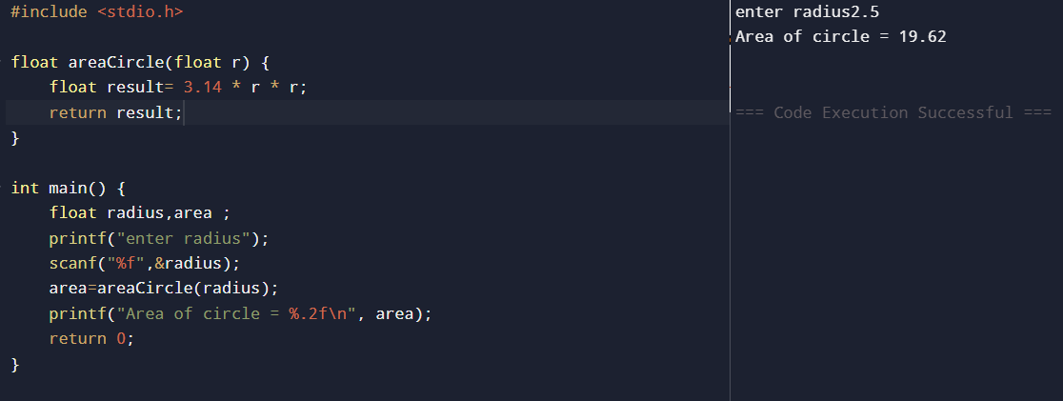
Area of a circle

Slide 19
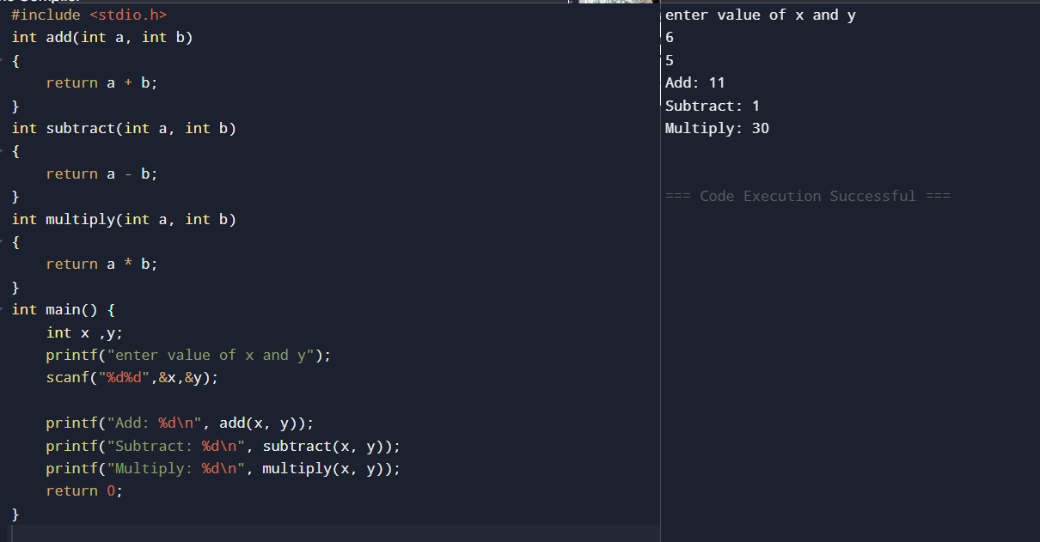
Simple calculator with functions

Slide 20
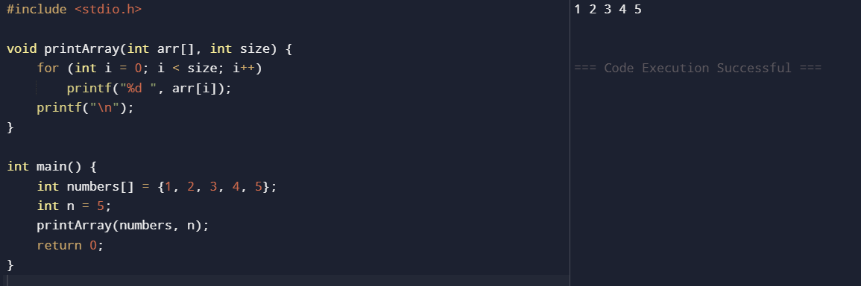
Print an array using a function

Slide 21
What are local variables?
Declared inside a function
Used only inside that function
Cannot be accessed outside

Slide 22
What are local variables?
#include <stdio.h>
void test() {
int a = 10; // local variable
printf("%d\n", a);
}
int main() {
test();
// printf("%d", a); // ERROR
}

Slide 23
What are global variables?
Declared outside all functions
Can be used in any function

Slide 24
What are global variables?
#include <stdio.h>
int g = 5; // global variable
void display() {
printf("%d\n", g);
}
int main() {
display();
printf("%d\n", g);
}

Slide 25
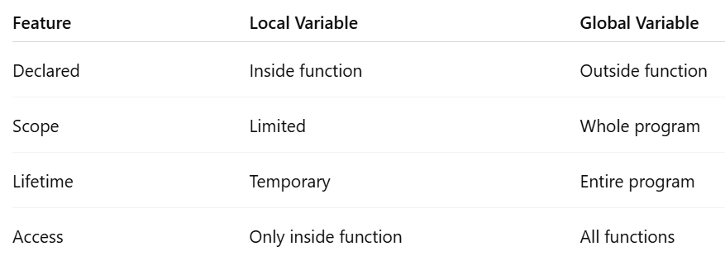
Difference between local and global variables?

Slide 26
Parameter Passing Mechanism
In C, parameter passing mechanism refers to how values or addresses are transferred from the calling function to the called function ( means how data is sent from one function to another.)
There are two main styles:
1. Call by value (pass by value)
2. Call by reference (using pointers)

Slide 27
Call by value (pass by value)
The function gets a copy of the value.
If the function changes the value, the original variable does not change.
This is the default way in C.

Slide 28
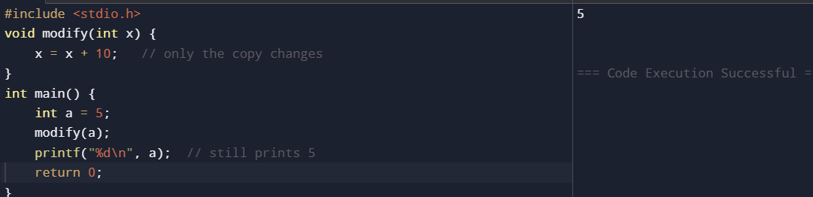
Call by value (pass by value)

Slide 29
Call by reference (using pointers)
The function gets the address (memory location) of the variable, using a pointer.
The function can change the original variable because it works on the real data

Slide 30
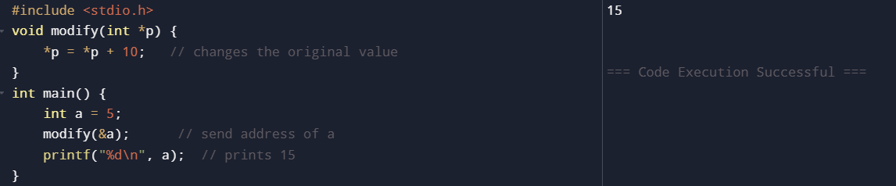
Call by reference (using pointers)

Slide 31
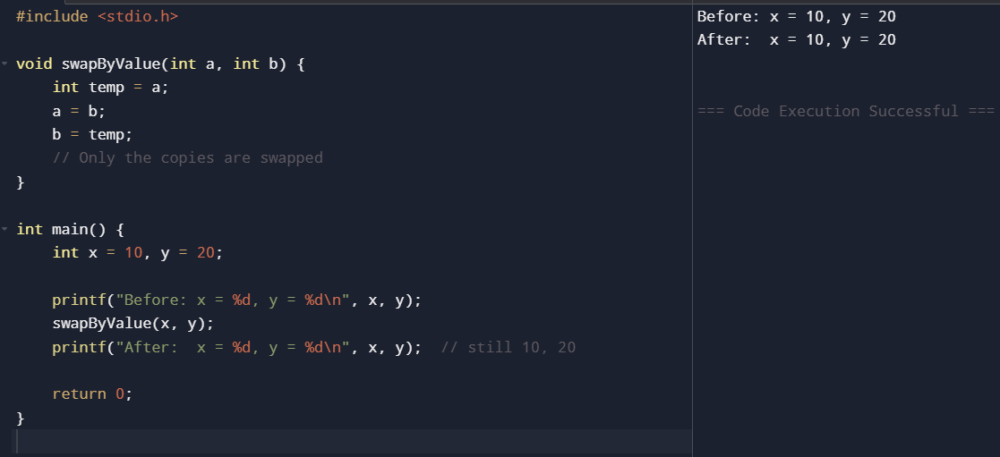
Call by value (values are copied, swapping does nothing)

Slide 32
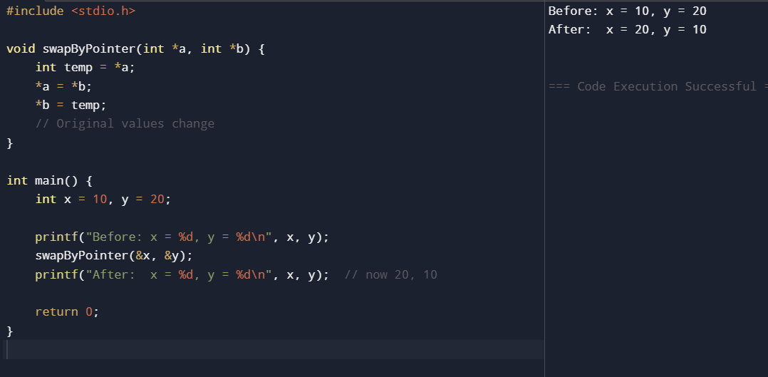
Call by reference (using pointers, actual values are swapped)

Slide 33
Command line arguments
When starting C programming, we use scanf() for input.
Command line arguments offer a better way—pass data right when running the program from the terminal.
This makes our code more flexible and dynamic.

Slide 34
Command line arguments
Command-line arguments are the values passed to a program when it is executed from the command prompt or terminal.
These arguments appear after the program name in the command line.
They allow the user to provide input without modifying the program code.
Example
./a.out file1.txt file2.txt (on terminal)
Here:
./a.out → Program name
file1.txt and file2.txt → Command-line arguments

Slide 35
Command Line Arguments in C
Syntax
The syntax of command-line arguments in C is
int main(int argc, char *argv[])
argc: Stands for argument count. It stores the total number of arguments passed, including the program name.
argv[]: Stands for argument vector. It is an array of character pointers (strings) listing all the arguments.

Slide 36
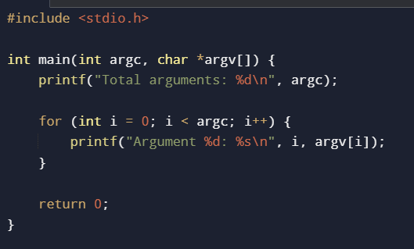
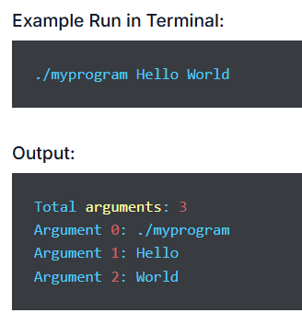
Command Line Arguments in C

Slide 37
What is argc in C?
argc means "argument count."
It's an integer that automatically counts all command-line arguments passed to your C program, including the program name itself as the first one.
Example:
./myprogram apple banana
Here, argc = 3 because:
./myprogram (argument 0 - program name)
apple (argument 1)
banana (argument 2)
Note : argc is always ≥ 1 (even with no extra arguments, it counts the program name).

Slide 38
What is argv[] in C?
argv[] means "argument vector."
It's an array of strings that holds each command-line argument.
How it works:
argv[0] = Program name (e.g., "./myprogram")
argv[1] = First argument (e.g., "apple")
argv[2] = Second argument (e.g., "banana")
Note: All arguments are stored as strings (even numbers like "123"). Use atoi() to convert numbers.

Slide 39
What is argv[] in C?
Example:
./myprogram apple 123
argv[0] = "./myprogram"
argv[1] = "apple"
argv[2] = "123"

Slide 40
How to Compile & Run C Program with Command Line Arguments
Step 1: Write your C program
Suppose we save it as argsdemo.c:
#include <stdio.h>
int main(int argc, char *argv[]) {
for(int i = 0; i < argc; i++) {
printf("Argument %d: %s\n", i, argv[i]);
}
return 0;
}

Slide 41
How to Compile & Run C Program with Command Line Arguments
Step 2: Compile using GCC
Open terminal and type:
gcc argsdemo.c -o argsdemo
gcc = compiler
-o argsdemo = output file name

Slide 42
How to Compile & Run C Program with Command Line Arguments
Step 3: Run with arguments
Linux/macOS:
./argsdemo apple mango banana
Windows:
argsdemo.exe apple mango banana
Output:
Argument 0: ./argsdemo
Argument 1: apple
Argument 2: mango
Argument 3: banana
Note: Argument 0 is always the program name itself!

Slide 43
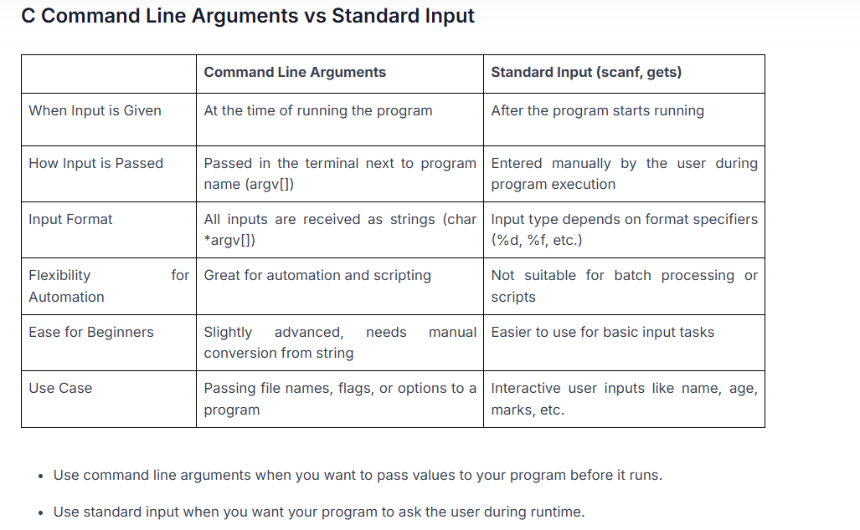

Slide 44
Storage Classes
In C variables act differently depending on where and how you declare them.
This is controlled by storage classes, which decide a variable's scope (where it's visible), lifetime (how long it lasts), visibility, and memory spot.

Slide 45
Storage Classes
Scope: Where you can use the variable.
Lifetime: How long the variable stays in memory.
Storage location: Where the variable is kept in memory.
Default initial value: What value it gets if you don't set one.

Slide 46
What Are Storage Classes in C?
A storage class in C controls:
Where a variable is stored in memory.
Its scope (where you can see/use it).
Its lifetime (how long it lasts).
How you access it in the program.
It decides if a variable is local/global, keeps its value between function calls, or lives in RAM/CPU register.
Analogy: Like worker roles—some are temporary (auto), some keep daily tasks (static), some are quick-access (register), some share across teams (extern).

Slide 47
Types of Storage Classes in C
There are 4 types of storage classes in C programming:
auto for temporary local variables.
register for high-speed variables stored in CPU registers.
static for persistent local or global variables.
extern for sharing global variables across multiple files.

Slide 48
Auto Storage Class in C
auto is the default for local variables inside functions.
Scope: Only inside that block/function.
Lifetime: Born when function starts; dies when it ends.
Memory: Stored in RAM.

Slide 49
Auto Storage Class in C
auto is the default for local variables in functions/blocks.
You rarely type auto—it's automatic.
Variables are created when the function starts and deleted when it ends.
Values don't stick around between calls.
#include<stdio.h>
int main()
{
auto int age = 23; // same as : int age = 23;
printf("%d",age);
}

Slide 50
Register Storage Class in C
Register hints to the compiler: "Put this variable in a fast CPU register, not regular memory." Speeds up frequent access.
Scope: Only in its block/function.
Lifetime: Starts with function; ends with it.
Memory: CPU register (if possible), else RAM.

Slide 51
Register Storage Class in C
#include<stdio.h>
int main()
{
register int count = 0;
printf("%d",count);
}
register: Hints compiler to use fast CPU register for quick access (e.g., loop counters).
It's just a suggestion—may use RAM instead.
Can't get its address with &

Slide 52
Static Storage Class in C
static keeps a variable's value between function calls—it doesn't get destroyed when the function ends.
Scope: Local (inside function) or global (outside).
Lifetime: Whole program run.
Memory: RAM.

Slide 53
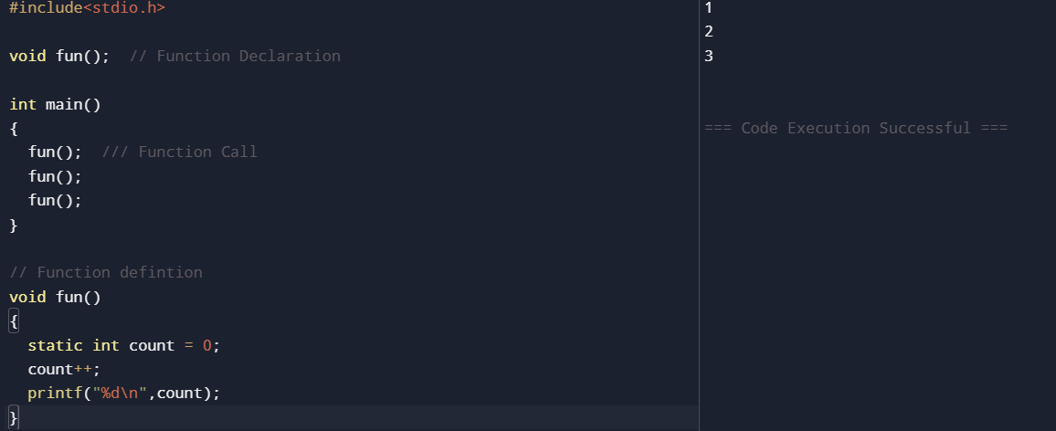
Static Storage Class in C

Slide 54
Static Variables in C
The static keyword makes variables behave specially:
For local variables (inside functions):
Retains value between function calls.
Initialized only once (at program start), not each call.
For global variables (outside functions):
Limits scope to this file only—other files can't access it.

Slide 55
Extern Storage Class in C
extern shares global variables across multiple files.
Scope: Global—accessible from any file.
Lifetime: Entire program run.
Memory: RAM.

Slide 56



Extern Storage Class in C
extern int count;
This tells the compiler:
“count is defined in another file, use it from there”
No memory is created here
#include <stdio.h>
// extern declaration (no memory allocation)
extern int count;
// Function declaration
void display();
int main()
{
printf("Count in main = %d\n", count);
display();
return 0;
}
#include <stdio.h>
// Global variable definition
int count = 10;
void display()
{
printf("Count = %d\n", count);
}
Count in main = 10
Count = 10

Slide 57
Extern Storage Class in C
extern: Links to variables/functions defined in other files.
No new memory—just tells compiler "it exists elsewhere."
Makes globals accessible everywhere.
extern → declares a variable, does not allocate memory
Used to share global variables between files
Variable must be defined in one file only
Other files use extern to access it

Slide 58
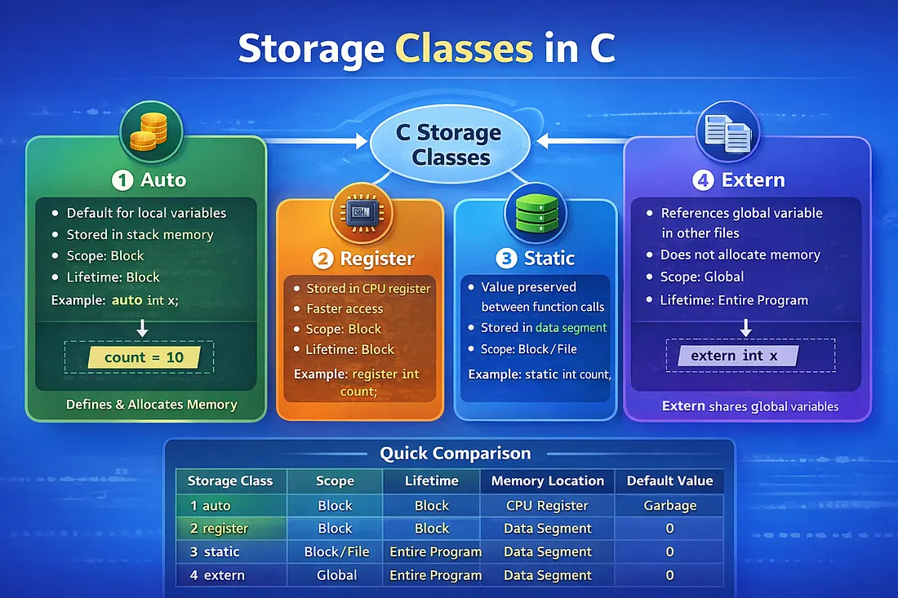
https://medium.com/@kumari01priyanka/bert-and-distilbert-model-for-nlp-7352eb16915e

